Slide 1
Philosophy of Enlightenment

Slide 2
Characteristic features of the Enlightenment philosophy
1) historical optimism is a type of scientific worldview that recognizes the progressive development of history exclusively in the direction of progress and improvement of civilization;
2) determinism – a kind of scientific worldview that recognizes the predestination of everything that happens in the world by universal laws and principles;
3) mechanistic materialism – a type of scientific worldview, according to which the surrounding world and nature are a global mechanism;

Slide 3
Object and subject of philosophy of the Enlightenment :
Оbject; criticism of the influence of the Catholic Church on the life of society and the existence of the state;
Subject;
Analysis of various aspects of social and individual existence ;
Creating theories of the origin of society and the State

Slide 4
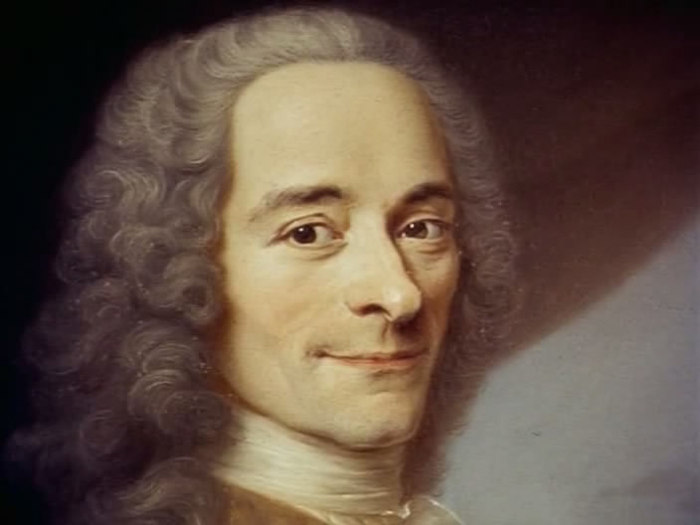
Fransua Voltaire (1694-1778) - french philosopher of deism

Slide 5
Basic ideas of Fransua Voltaire ’s philosophy
1)He was founder of deism – a philosophical theory that recognized e creation of the world by God, but denied its decisive role in the further development of the world and human life
2)He was author of the concept: "enlightened absolutism" is a type of power in which the ruler of the state pays special attention to the development of the sciences and arts, sets a personal example of enlightenment to the subjects and does not even infringe on some of their rights and freedoms.
3) Voltaire created a concept philosophy of history;
4) Main books: "Candide, or optimism", " Philosophical Dictionary»

Slide 6
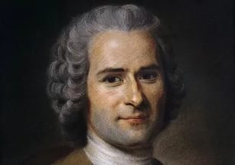
Jean-Jacques Rousseau (1712-1778) - french philosopher of idealism

Slide 7
The main ideas of the book “The issue about the eternal World" by Rousseau
1) criticized wars as a way to solve political problems;
2) advocated for increasing the role of international diplomacy in resolving military conflicts;
3) considered the revolution a " social evil»;
4) spoke in favor of the creation of a union of European states;

Slide 8
The problem of inequality and its solution in Rousseau's philosophy
The problem of inequality
The theory of "natural man"
Rousseau singled out:
1) biological (innate) and social (acquired) inequalities;
2) the first cannot be corrected, the second –can be;
3) considered the high level of social inequality as one of the possible causes of revolutions.
Russo believed that for elimination of inequality, people need to give up the benefits of civilization and return to life in a natural environment(nature)

Slide 9
Theory of social contract
1) S.C. is the concept that explains the creation of society and the state is the result of an ontological contract between people;
2) the condition of the contract: the state provides society with protection and prosperity, the society renounces part of its rights and freedoms;
3) the condition of termination of the contract: possible if the state does not fulfill its obligations;

Slide 10
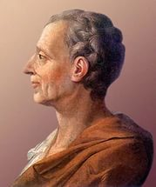
Charles de Montesquieu (1712-1755) french philosopher of geographical determinism

Slide 11
Basic ideas of Charles de Montesquieu ’s philosophy
1) his main book was titled “The power of climate”;
2) he was author of the principle geographical determinism – type of philosophy, defining geography as a main factor of political, economical and cultural development of the state
3) he critisized the absolute monarhy in France and believes that this type of government is full of disadvantage;
4) he was agree with the principle of separation of powers by John Locke;

Slide 12
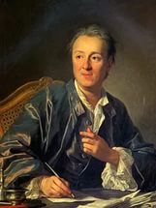
Deni Diderot (1736-1784) french philosopher of scientific materialism

Slide 13
Basic ideas of Deni Diderot’s philosophy
1) his main book was titled “Encyclopedia of Sciences, Arts and Crafts”;
2) he was author of the principle of dialogical logic of the development of nature, society and man;
3) he critisized the influence of Catholic church on the development of state and life of society
4) he believes that we can explore the world only by science but not by religion;
5) scientific materialism-this is the type of philosophy wich is based on natural sciences

Slide 14
Summary
Name of philosopher | Type of his philosophy | Basic concept
Francois Voltair | deism | Philosophy of history
Jean-Jacques Rousseau | idealism | Social contract
Charles de Montesquieu Deni Diderot | materialism scientific materialism | geographical determinism

